Slide 1

01
floaten bit
Building dreams since 2024

Slide 2
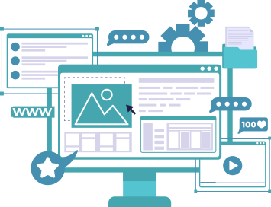
web categorizer
easy use

Slide 3

A web categorizer organizes web information into a hierarchical structure, creating spaces, categories, and subcategories. It provides a systematic approach to managing and accessing diverse online content.

Slide 4
Features of Web Categorizer
Spaces in Web Categorizer
Categories and Subcategories
Parent Subcategories for Hierarchies
Visualizations and Functionalities

Slide 5

Benefits of Using a Web Categorizer
Efficient Information Retrieval
Structured Knowledge Organization
.

Slide 6
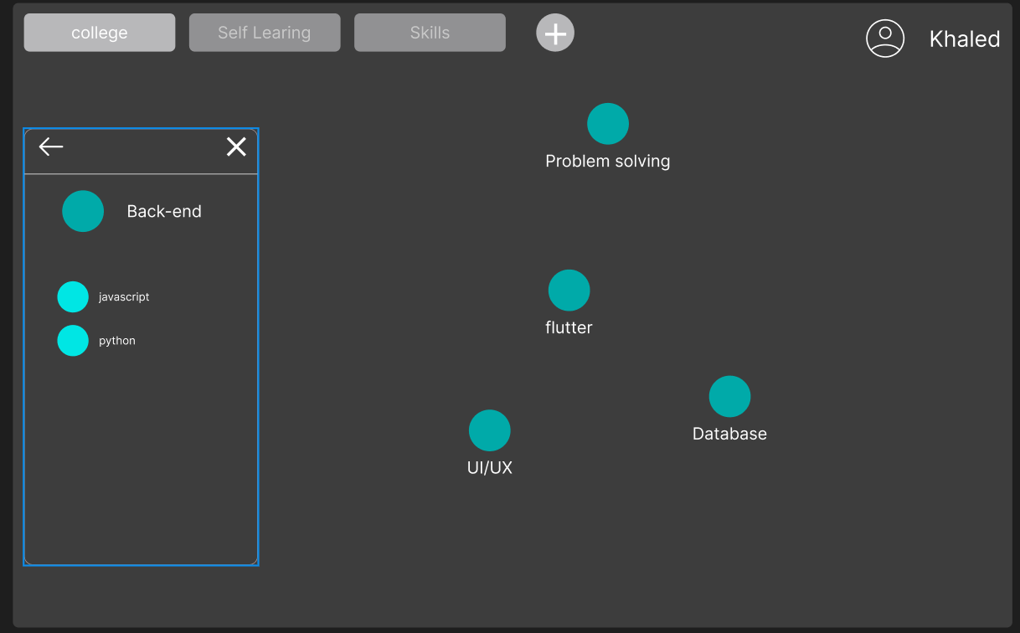

Slide 7
use cases
dynamic College Dashboard
multi interests people

Slide 8
thank you for lisnting

